Slide 1
Survival Analysis &
TTL Optimization
Rob Lancaster, Orbitz Worldwide

Slide 2
Outline
The Problem
Survival Analysis
  Intro
  Key Terms
  Techniques & Models:
    Kaplan-Meier Estimates
    Parametric Models
Optimizing Cache TTL
  Methods
  Results

Slide 3
The Problem
The hotel rate cache and TTL optimization.

Slide 4
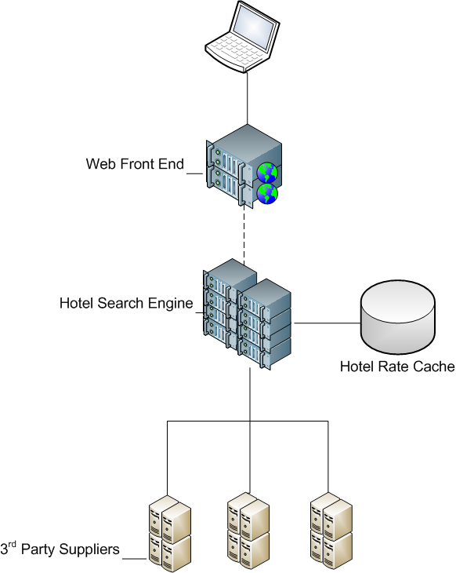
The Hotel Rate Cache

Slide 5
The Hotel Rate Cache
Key/Value Store
  Key: Search Criteria
  Value: Hotel Rate Information
Benefit = Reduce looks & latency
Cost = Increased re-price errors
hotel id | check-in | # people
host | check-out | # rooms

Slide 6
The Hotel Rate Cache
Each cache entry is given a time-to-live (TTL)
TTLs set based on intuition ages ago.
Goal: Optimize TTL to decrease looks, control re-price errors
How? Ideally, find greatest TTL value at which probability of rate change is below an acceptable threshold.

Slide 7
Survival Analysis
A brief? introduction.

Slide 8
What is Survival Analysis?
Statistical procedures for predicting time until an event occurs.
Event: death, relapse, recovery, failure.
Examples:
  Heart transplant patients:
    Time until death.
  Leukemia patients in remission:
    Time until relapse.
  Prison parolees:
    Re-arrest.

Slide 9
Key Terms
Survival Time, T vs. t
Failure
Censoring
Survival Function

Slide 10
Censoring
Period of no information
  Left-censored.
  Right-censored.
Causes:
  Individual is “lost” to follow-up
  Death from cause unrelated to event of interest
  Study ends
Models assume either failure or censoring.

Slide 11
Survival Function
Survival Function: S(t)
Probability of survival greater than t,
i.e. that T > t
Properties:
  Non-increasing
  S(t) = 1, for t=0.
  S(t) = 0, t=∞

Slide 12
Kaplan-Meier Estimates
t_{j}: observation time
m_{j}: number of failures
q_{j}: number of censored observations
n_{j}: number at risk
t_{j} | m_{j} | q_{j} | n_{j}
0 | 0 | 0 | 14
1 | 1 | 0 | 14
2 | 1 | 1 | 13
4 | 2 | 1 | 11
6 | 0 | 2 | 8
7 | 1 | 0 | 6
9 | 1 | 0 | 5
10 | 2 | 2 | 4

Slide 13
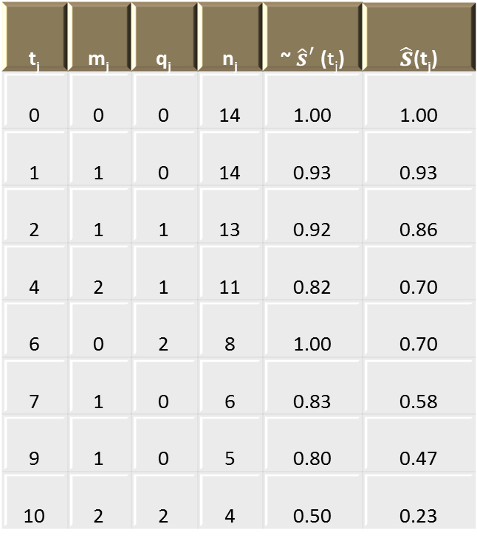

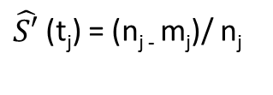
Kaplan-Meier Estimates
t_{j} | m_{j} | q_{j} | n_{j} | ~ $\hat{s}′$(t_{j}) | $\hat{s}$(t_{j})
0 | 0 | 0 | 14 | 1.00 | 1.00
1 | 1 | 0 | 14 | 0.93 | 0.93
2 | 1 | 1 | 13 | 0.92 | 0.86
4 | 2 | 1 | 11 | 0.82 | 0.70
6 | 0 | 2 | 8 | 1.00 | 0.70
7 | 1 | 0 | 6 | 0.83 | 0.58
9 | 1 | 0 | 5 | 0.80 | 0.47
10 | 2 | 2 | 4 | 0.50 | 0.23
$\hat{S′}$(t_{j}) = (n_{j -} m_{j})/ n_{j}
$\hat{s}$(t_{j}) = $\hat{s}$(t_{j-1}) * $\hat{S′}$(t_{j})

Slide 14




Parametric Models
Accelerated Failure Time
Assume distribution
Use regression to fit parameters.
λ is parameterized in terms of predictor variables and regression parameters.
Distribution | S(t)
Exponential
Weibull
Log-logistic

Slide 15
Optimizing Cache TTL
Methods and early results.

Slide 16
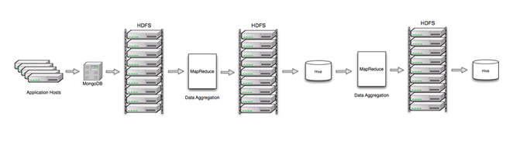
Data Collection
Data is collected from service hosts in our hotel stack.
Includes every live rate search (aka burst) performed by our hotel stack.
Raw data: ~200 GB, compressed, 10⁸ records.
Extraction: <40 GB compressed, 10⁹ records.

Slide 17
Data Preparation
  Map/Reduce Job
    Key: unique search criteria (including hotel id)
    Sorted by date of occurrence
    Most important output:
      Does rate ever change? (how long)
      Does status ever change? (how long)
  Results stored in Hive Table
    Predictors: location, lead time, los, chain, etc.
    Survival Analysis Variables: event, survival time

Slide 18
Data Preparation: Sample
Key: hotelid:checkin:checkout:ppl:rms | Timestamp | Status | Rate | Status Change | Hours Until Status Change | Rate Change | Hours Until Rate Change
12345:2012-03-01:2012-03-02:2:1 | 2012-01-10 5:00 | Available | $100 | TRUE | 6 | TRUE | 6
12345:2012-03-01:2012-03-02:2:1 | 2012-01-10 8:00 | Available | $100 | TRUE | 3 | TRUE | 3
12345:2012-03-01:2012-03-02:2:1 | 2012-01-10 11:00 | Unavailable | N/A | TRUE | 8 | N/A | N/A
12345:2012-03-01:2012-03-02:2:1 | 2012-01-10 13:00 | Unavailable | N/A | TRUE | 6 | N/A | N/A
12345:2012-03-01:2012-03-02:2:1 | 2012-01-10 14:00 | Unavailable | N/A | TRUE | 5 | N/A | N/A
12345:2012-03-01:2012-03-02:2:1 | 2012-01-10 17:00 | Unavailable | N/A | TRUE | 2 | N/A | N/A
12345:2012-03-01:2012-03-02:2:1 | 2012-01-10 19:00 | Available | $120 | FALSE | N/A | TRUE | 4
12345:2012-03-01:2012-03-02:2:1 | 2012-01-10 22:00 | Available | $120 | FALSE | N/A | TRUE | 1
12345:2012-03-01:2012-03-02:2:1 | 2012-01-10 23:00 | Available | $150 | FALSE | N/A | FALSE | N/A
12345:2012-03-01:2012-03-02:2:1 | 2012-01-11 1:00 | Available | $150 | FALSE | N/A | FALSE | N/A
12345:2012-03-01:2012-03-02:2:1 | 2012-01-11 3:00 | Available | $150 | N/A | N/A | N/A | N/A

Slide 19
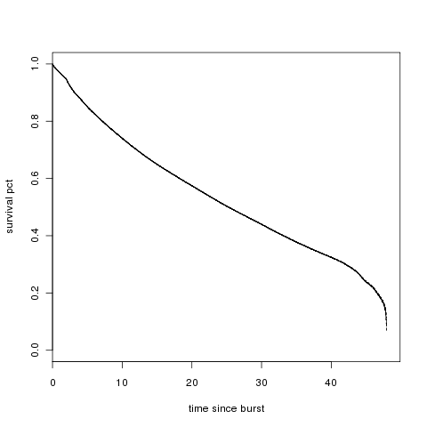
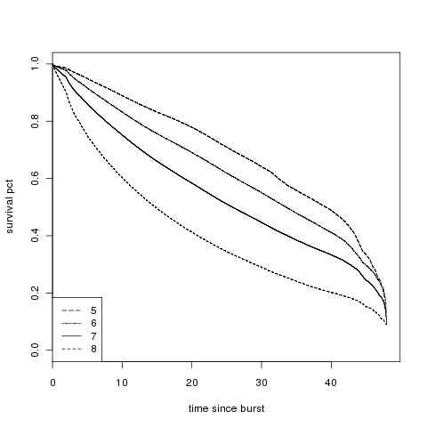
KM Estimates
Global
By Traffic Volume

Slide 20
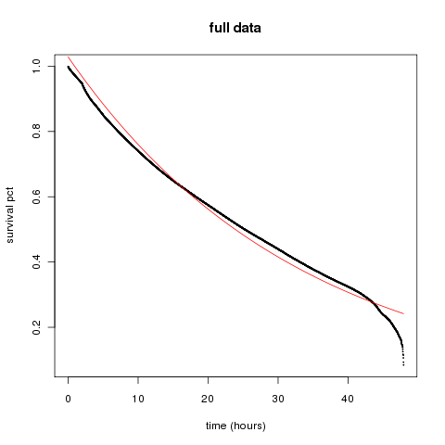



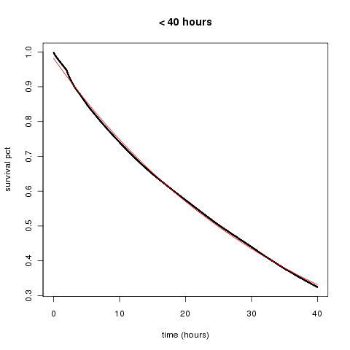
Fitting the Survival Curve
Assume exponential:
Apply simple linear regression.
  Full data R²: 0.9671
  40 hrs R²: 0.999

Slide 21

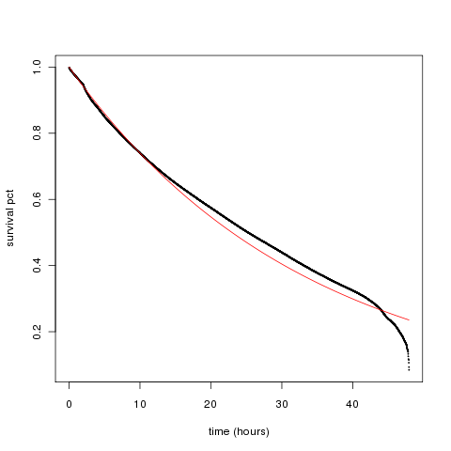
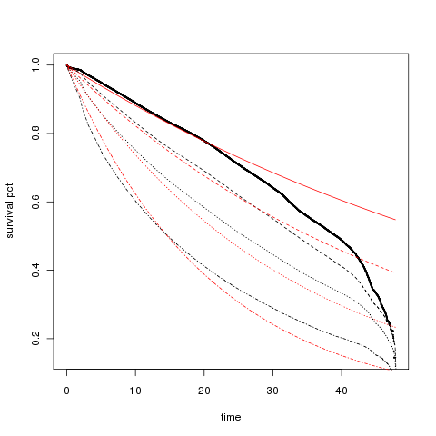
Survival Regression
Using survreg, we can fit our data to a given distribution.
Allows us to capture influence of predictor values on survival rate.

Slide 22
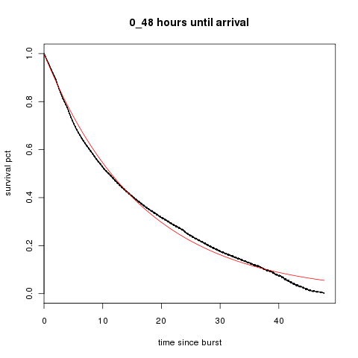
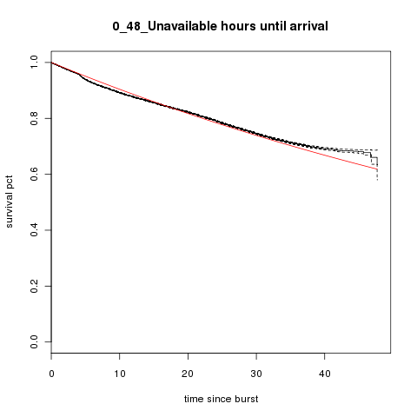
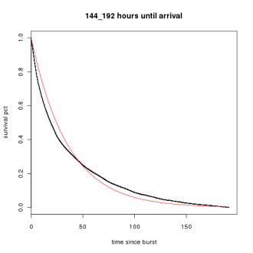
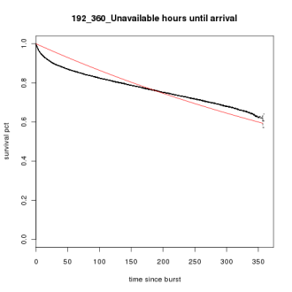
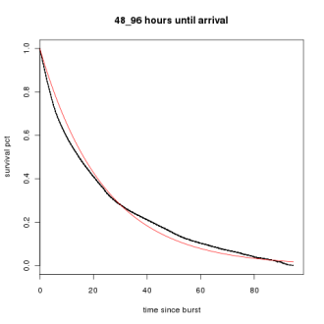
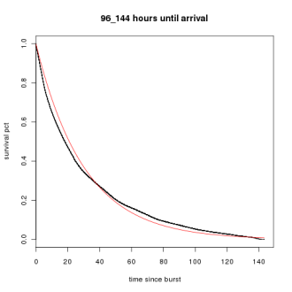
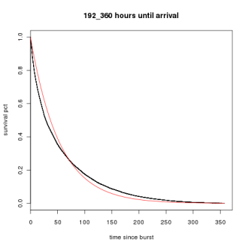
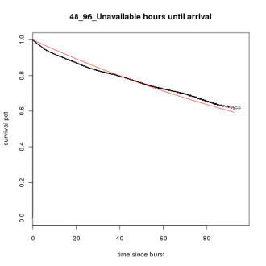
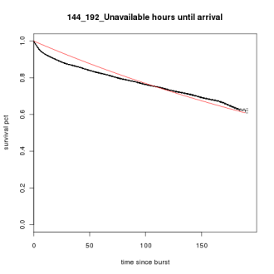
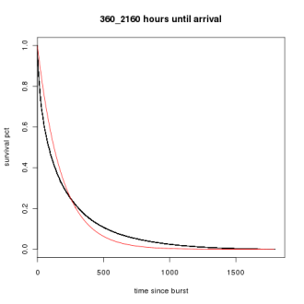

Model Families

Slide 23
Production Testing
Divided hotels in 8 markets into A & B groups
Modified TTL values for unavailable rates for B
Prediction:
  Reduce the number of “looks” to B
  Reduce the unavailability percentage for B
  No negative impact on bookings or look-to-books for B

Slide 24
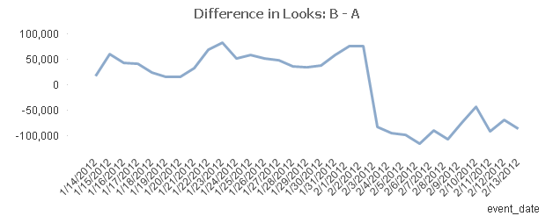
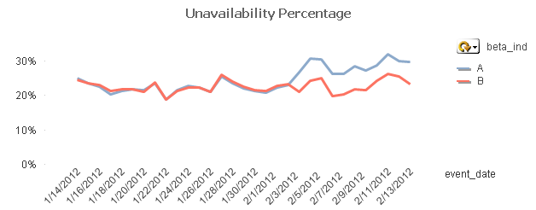
Production Results

Slide 25
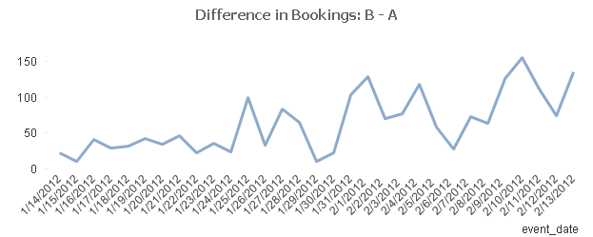
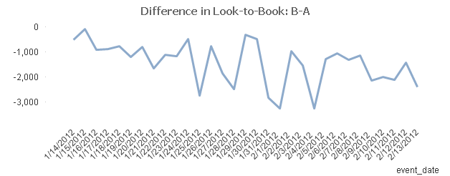
Production Results

Slide 26
Conclusions and Next Steps
Conclusions
  Survival Analysis is well-suited for our problem.
  Great success in experiments for unavailable rates.
What’s next?
  Available rates
  Introduction of predictor variables
  On-the-fly TTL calculation
  Beyond TTL…

Slide 27
Thank you!
Questions?

